Slide 1
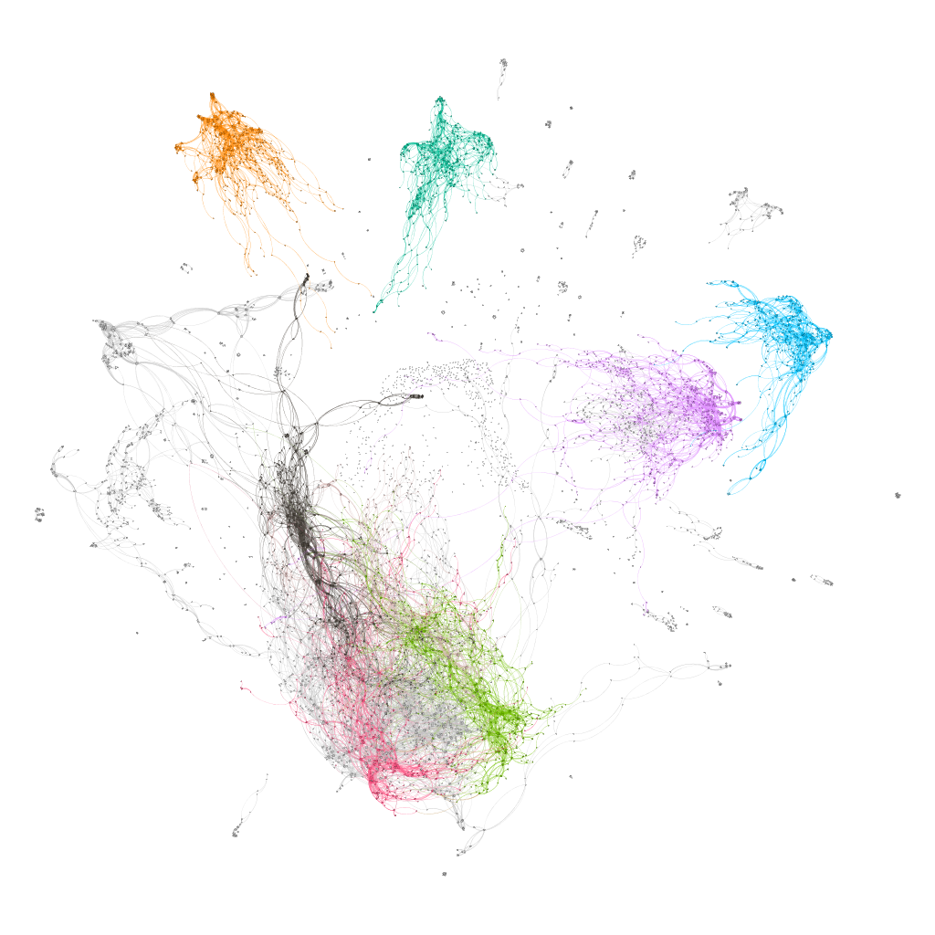
Topology of networks in generalized musical spaces
Marco Buongiorno Nardelli
CEMI – Center for experimental Music and Intermedia
iARTA – Initiative for Advanced Research in Technology and the Arts
Department of Physics
University of North Texas
www.materialssoundmusic.com

Slide 2
Topology of networks in generalized musical spaces
Construction of generalized musical spaces - pitch class sets of arbitrary cardinality and temperament
Dictionaries from the extension of traditional OPTIC transformations, and
Representation of generalized musical spaces as networks (graphs)
Introduction of navigational operators based on “distance”: quantification of musical “motion”
Computational framework for composition and analysis – example: common practice harmony in triadic space
Marco Buongiorno Nardelli
CEMI – Center for experimental Music and Intermedia
iARTA – Initiative for Advanced Research in Technology and the Arts
Department of Physics
University of North Texas
www.materialssoundmusic.com

Slide 3

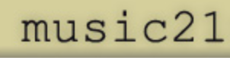
pcsPy: a python utility for generalized pitch class set classification, analysis and composition
The PCSet class:
pcs operations generalized to arbitrary temperament:
Transpose
Inverse
Normal order
Prime form
Interval vector
LISV vector
pcs classification
…etc.
Network and graph analysis functions:
Dictionary of pcs with arbitrary cardinality
Network construction with user-defined metric (distance)
Interval vector networks
Voice leading networks
ego-networks
… etc.

Slide 4
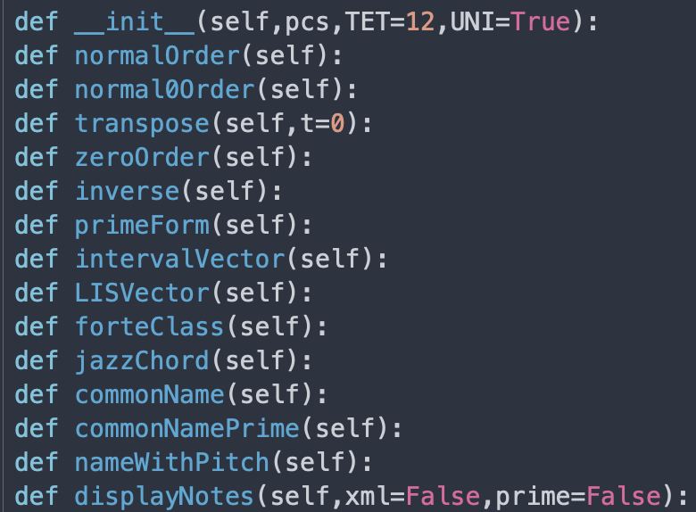
pcsPy: a python utility for generalized pitch class set classification, analysis and composition
The PCSet class:

Slide 5
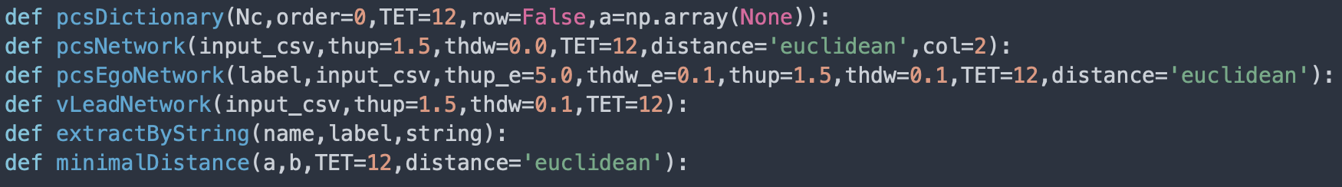
pcsPy: a python utility for generalized pitch class set classification, analysis and composition
Network and graph analysis functions:
Distance as metric in the musical space
Euclidean distance: ordinary straight line distance between two points in the chosen musical space (Pythagoras theorem)
interval vector (IV) distance: IVs are naturally ordered and their distance can be calculated directly
voice leading distance: minimal distance between pcs (with proper normalization – see later…!)
Two different representations of the musical space!

Slide 6
Dictionaries
Generalized dictionary of pcs for arbitrary temperament – universal classification

Slide 7
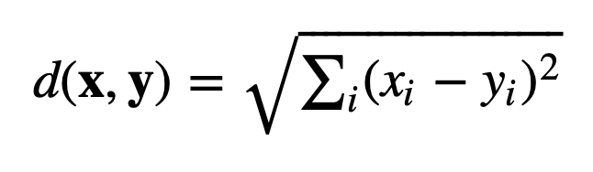
Topology in the interval vector space
operator | distance | weight
O(1) | 1.0000 | 1.0000
O(1,1) | 1.4142 | 0.7071
O(1,1,1) | 1.7321 | 0.5774
O(2) | 2.0000 | 0.5000
O(1,1,1,1) | 2.0000 | 0.5000
O(1,2) | 2.2361 | 0.4472
O(1,1,1,1,1) | 2.2361 | 0.4472
O(2,1,1) | 2.4494 | 0.4083
O(1,1,1,1,1,1) | 2.4495 | 0.4082
O(2,1,1,1) | 2.6457 | 0.3780
O(2,1,1,1,1) | 2.8284 | 0.3536
O(2,2) | 2.8284 | 0.3536
O(2,1,1,1,1,1) | 3.0000 | 0.3333
O(2,2,1) | 3.0000 | 0.3333
O(3) | 3.0000 | 0.3333
O(1,3) | 3.1622 | 0.3162
O(2,1,1,1) | 3.1622 | 0.3162
O(1,1,3) | 3.3166 | 0.3015
O(1,1,1,2) | 3.4641 | 0.2887
O(2,3) | 3.6056 | 0.2774
O(1,2,3) | 3.7416 | 0.2673
O(4) | 4.0000 | 0.2500
More on distances:
Weight = 1/distance
Distance Operator: i-th pc in the pcs is changed by n (integer):
O({n_{i}}) as O(1,1,2) = two elements are raised or lowered by 1, one is raised or lowered by 2 – all permutations possible
Operators must have dimensions ≤ dim(IntervalVector) ≡ TET/2

Slide 8
Topology in the interval vector space
operator | distance | weight
O(1) | 1.0000 | 1.0000
O(1,1) | 1.4142 | 0.7071
O(1,1,1) | 1.7321 | 0.5774
O(2) | 2.0000 | 0.5000
O(1,1,1,1) | 2.0000 | 0.5000
O(1,2) | 2.2361 | 0.4472
O(1,1,1,1,1) | 2.2361 | 0.4472
O(2,1,1) | 2.4494 | 0.4083
O(1,1,1,1,1,1) | 2.4495 | 0.4082
O(2,1,1,1) | 2.6457 | 0.3780
O(2,1,1,1,1) | 2.8284 | 0.3536
O(2,2) | 2.8284 | 0.3536
O(2,1,1,1,1,1) | 3.0000 | 0.3333
O(2,2,1) | 3.0000 | 0.3333
O(3) | 3.0000 | 0.3333
O(1,3) | 3.1622 | 0.3162
O(2,1,1,1) | 3.1622 | 0.3162
O(1,1,3) | 3.3166 | 0.3015
O(1,1,1,2) | 3.4641 | 0.2887
O(2,3) | 3.6056 | 0.2774
O(1,2,3) | 3.7416 | 0.2673
O(4) | 4.0000 | 0.2500
More on distances:
Paradigm shift!
OPTIC generate the intrinsic structure of the desired network – distance operators (O({n_{i}})) provide the navigational tools of the musical space – functionality!
The topology of the network is a representation of the traditional properties of pcs:
Octave shift (O)
Permutation (P)
Transposition (T)
Inversion (I)
Cardinality change (C)
Distance in the network provides the effective definition of the operators that allow the navigation of the musical space

Slide 9
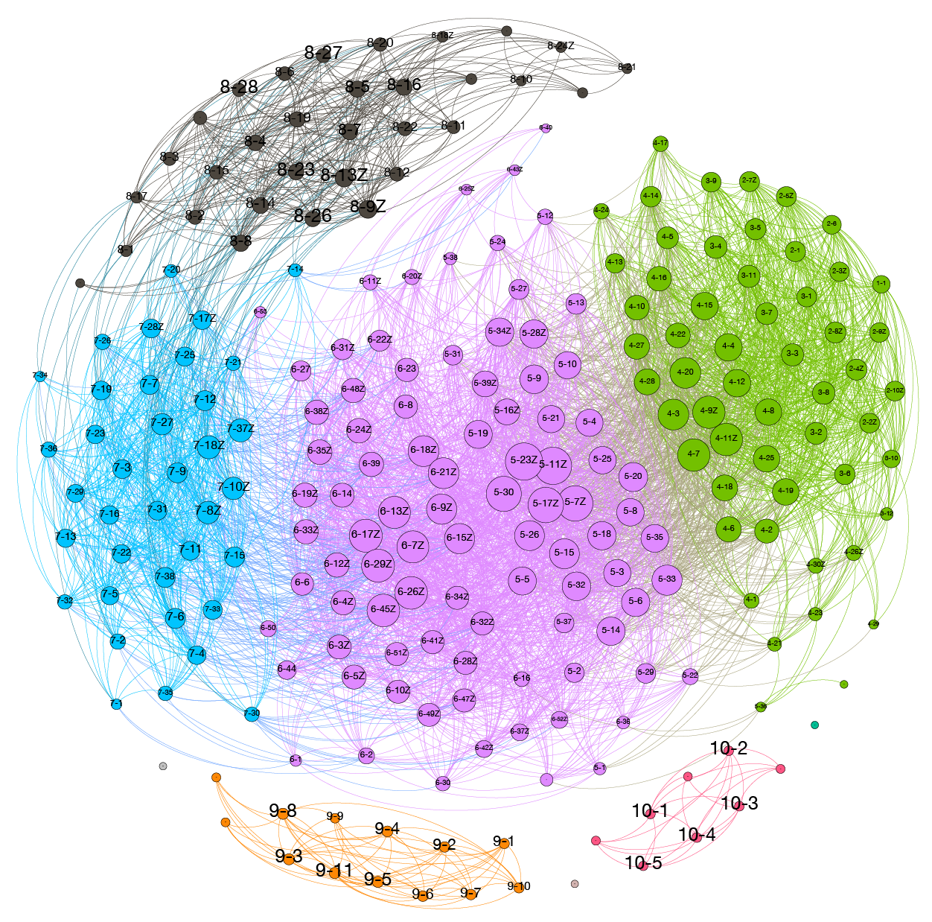
Topology of the 12TET interval vector space
Classification based on distances between IVs
Nodes are connected for distances larger than 1 and less or equal 4

Slide 10
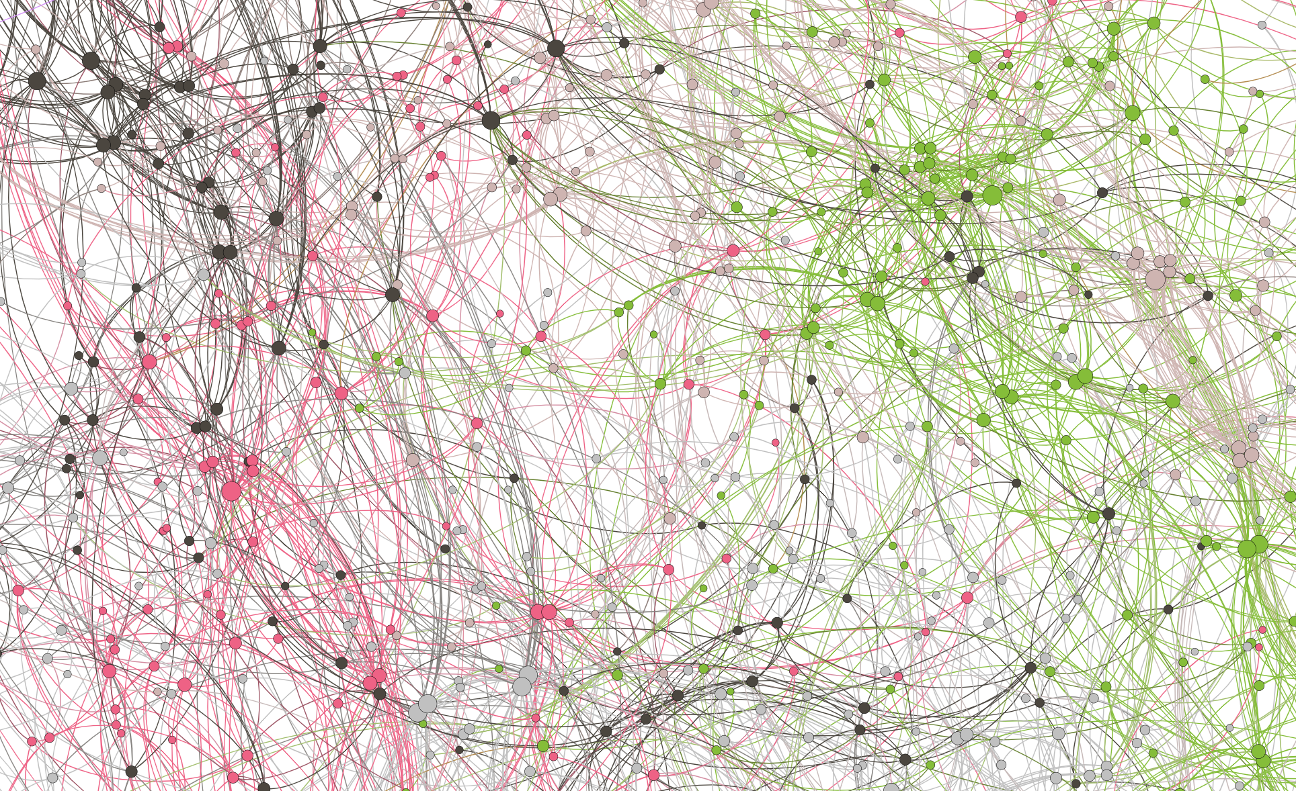
Topology of the 7-pitch class sets of the
24TET interval vector space
7478 unique prime forms with 1715 Z-related sets
Classification based on distances between IVs
Nodes are connected for distances up to O(2) and O(1,1,1,1) (distance=2)

Slide 11
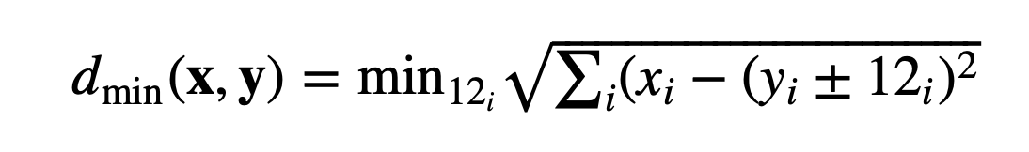
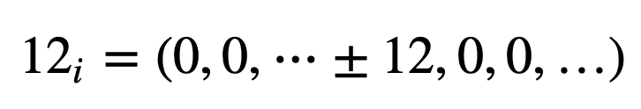
Topology of the voice leading vector spaces
Classification based on minimal distance between pcs of same cardinality
Start from normal ordered pcs x and y of same cardinality (w/o allowing repetitions of pitches – bijective or non bijective)
Calculate the minimal distance as
where 12_{i} is a vector of all zeros but ±12 at position i for all permutations of i:
Paradigm shift!
OPTIC generate the intrinsic structure of the desired network – distance operators (O({n_{i}})) provide the navigational tools of the musical space – functionality!
Minimal hand motion on keyboard

Slide 12
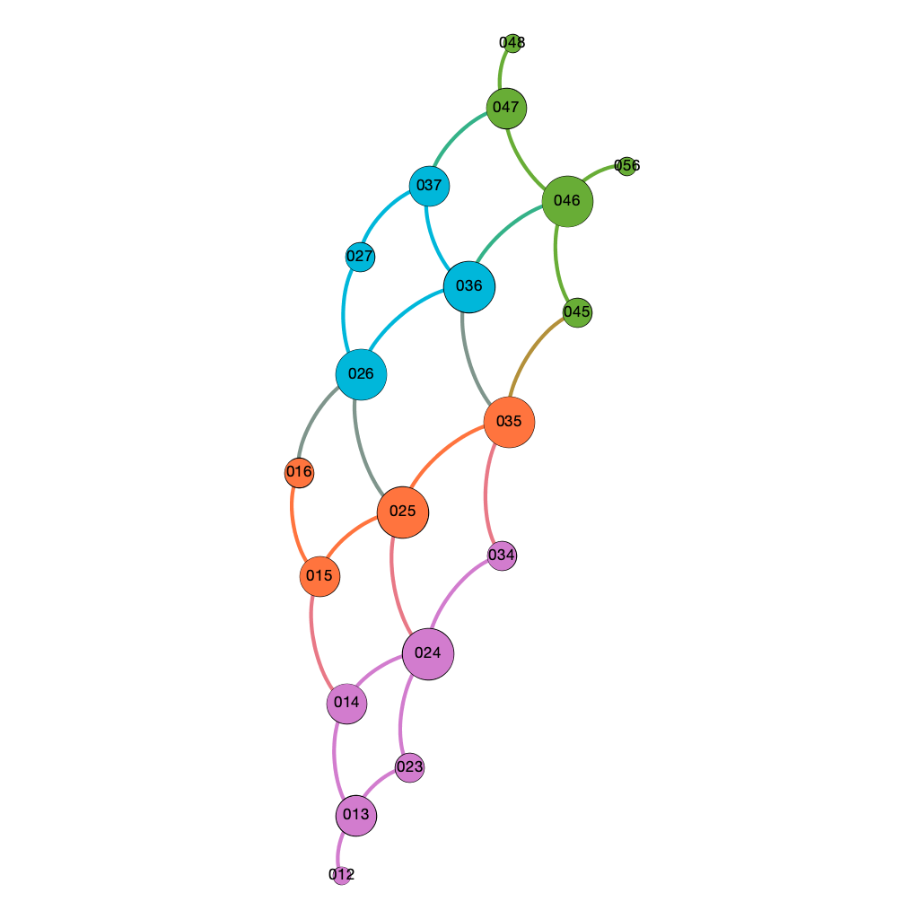
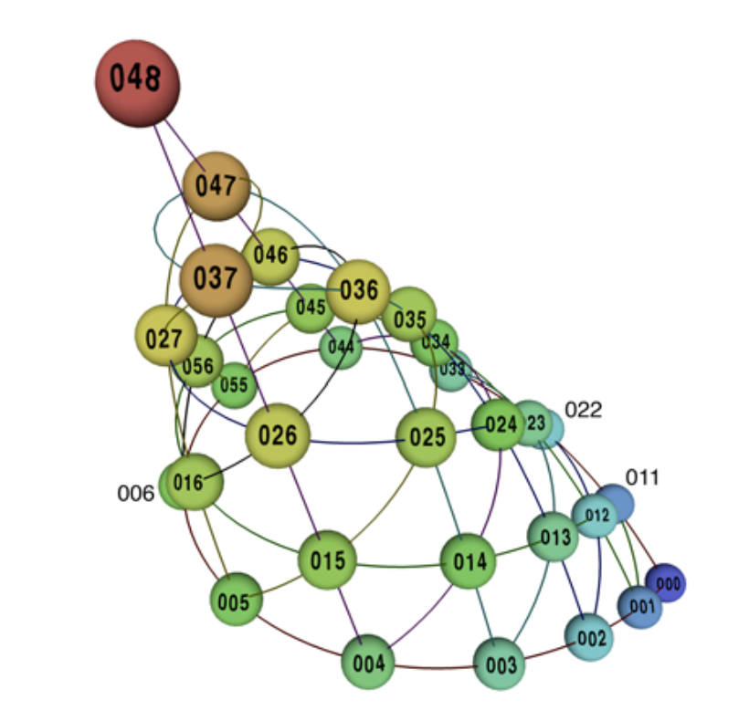
Triadic harmony in 12TET
Classification based on minimal distance between pcs of cardinality 3
Octave equivalent normal forms (prime forms + inversions = OPT) + O(1)
aug
min
Maj
add2
Quotient space 𝕋²/𝒮₃ as a cone
dim
Maj b5
All the information is contained in the metric!
Callender, Quinn and Tymoczko, Science 320, 346 (2008)

Slide 13
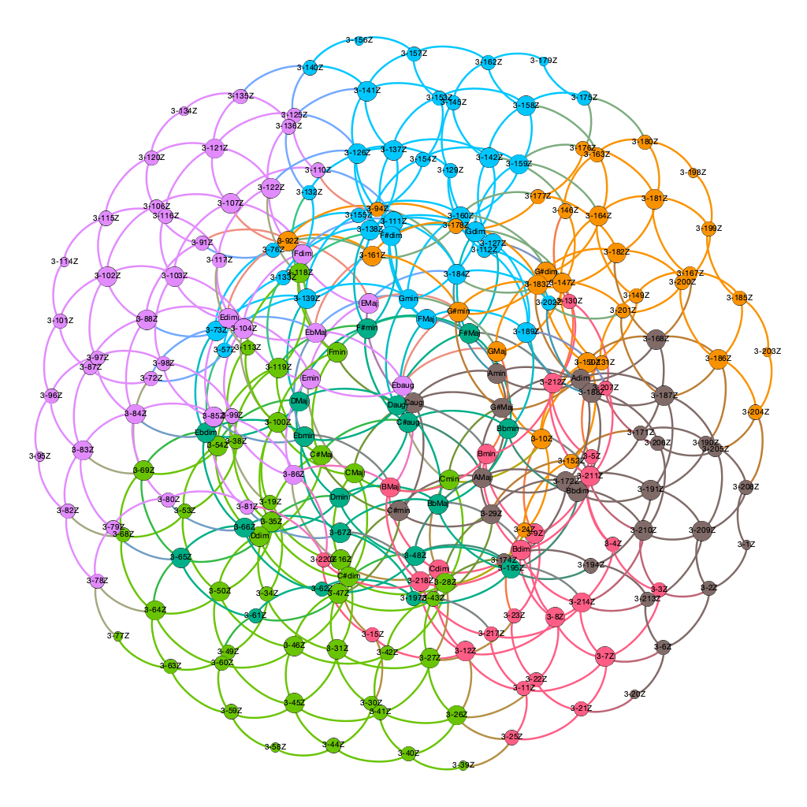
panchromatic normal forms (prime forms + inversions) + O(1)
Triadic harmony in 12TET
panchromatic voice leading spaces
Generalization of the concept of “orbifold”
Share the same topological characteristics: "Chords that divide the octave evenly lie at the center of the orbifold and are surrounded by the familiar sonorities of Western tonality” (Tymoczko, Science, 2006)

Slide 14
Triadic harmony in 12TET
panchromatic voice leading spaces
Even some more on distances!
Order of operator O({n_{i}}) is related to functionality in the voice leading space:
operator | distance | weight
O(1) | 1.0000 | 1.0000
O(1,1) | 1.4142 | 0.7071
O(1,1,1) | 1.7321 | 0.5774
O(2) | 2.0000 | 0.5000
O(1,2) | 2.2361 | 0.4472
O(2,1,1) | 2.4494 | 0.4083
O(2,2) | 2.8284 | 0.3536
O(2,2,1) | 3.0000 | 0.3333
O(3) | 3.0000 | 0.3333
O(1,3) | 3.1622 | 0.3162
O(1,1,3) | 3.3166 | 0.3015
O(2,2,2) | 3.4641 | 0.2886
O(2,3) | 3.6056 | 0.2774
O(1,2,3) | 3.7416 | 0.2673
O(4) | 4.0000 | 0.2500
aug ⇨ Maj ⇨ min ⇨ dim, etc.
Color of nodes = modularity class ➝ measure of the strength of division of a network into communities: dense connections between the nodes within communities but sparse connections between nodes in different communities.

Slide 15
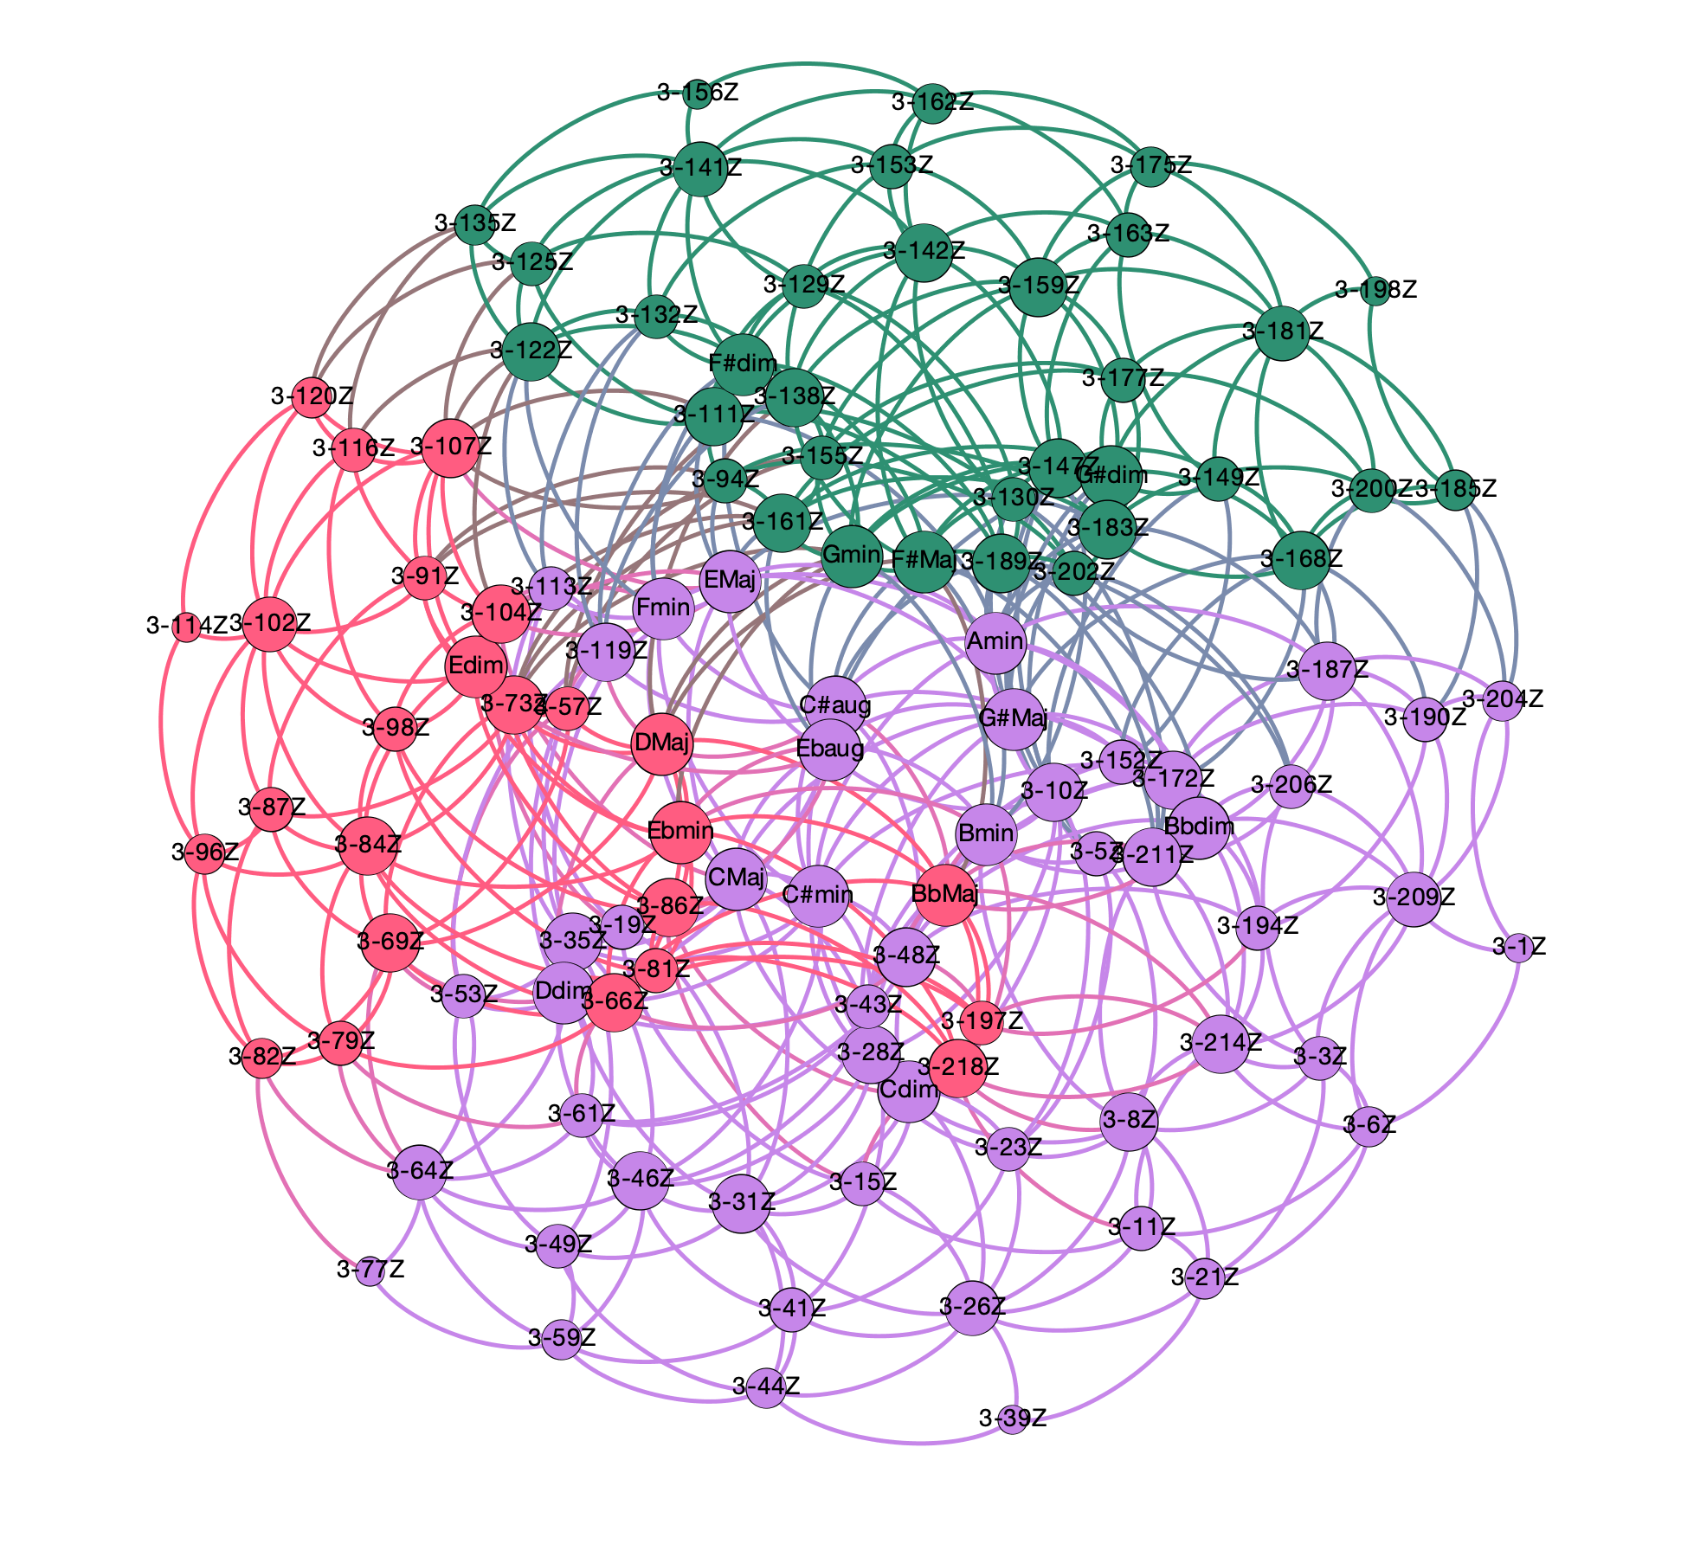
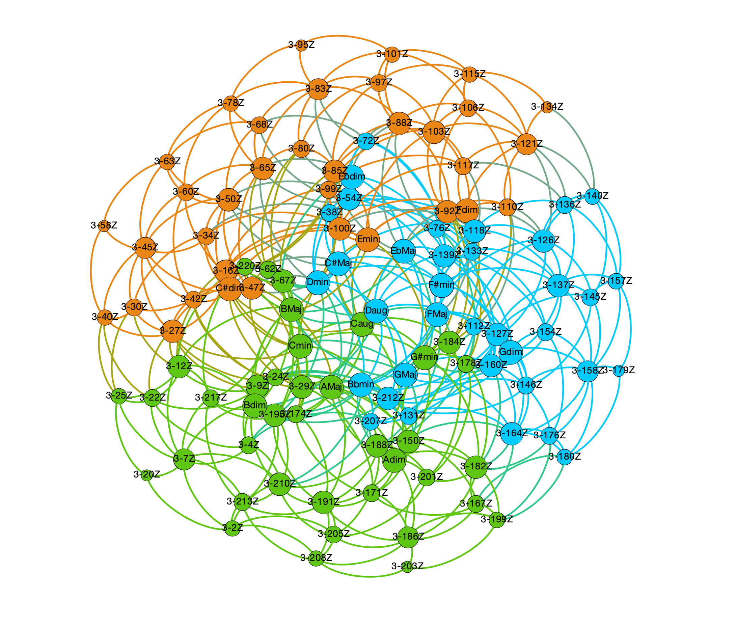
panchromatic normal forms (prime forms + inversions) + O(1,1)
Maj | Min | dim
C# | A# | C#
Eb | C | Eb
F | D | F
G | E | G
A | F# | A
B | G# | B
Triadic harmony in 12TET
panchromatic voice leading spaces
Maj | Min | dim
C | A | C
D | B | D
E | C# | E
F# | Eb | F#
G# | F | G#
Bb | G | Bb

Slide 16
Triadic harmony in 12TET
panchromatic voice leading spaces
Even some more on distances!
Order of operator O({n_{i}}) is related to functionality in the voice leading space:
operator | distance | weight
O(1) | 1.0000 | 1.0000
O(1,1) | 1.4142 | 0.7071
O(1,1,1) | 1.7321 | 0.5774
O(2) | 2.0000 | 0.5000
O(1,2) | 2.2361 | 0.4472
O(2,1,1) | 2.4494 | 0.4083
O(2,2) | 2.8284 | 0.3536
O(2,2,1) | 3.0000 | 0.3333
O(3) | 3.0000 | 0.3333
O(1,3) | 3.1622 | 0.3162
O(1,1,3) | 3.3166 | 0.3015
O(2,2,2) | 3.4641 | 0.2886
O(2,3) | 3.6056 | 0.2774
O(1,2,3) | 3.7416 | 0.2673
O(4) | 4.0000 | 0.2500
aug ⇨ Maj ⇨ min ⇨ dim, etc.
Cmaj ⇨ Fmin ⇨ F#dim ⇨ F#Maj, etc.
Color of nodes = modularity class ➝ measure of the strength of division of a network into communities: dense connections between the nodes within communities but sparse connections between nodes in different communities.

Slide 17
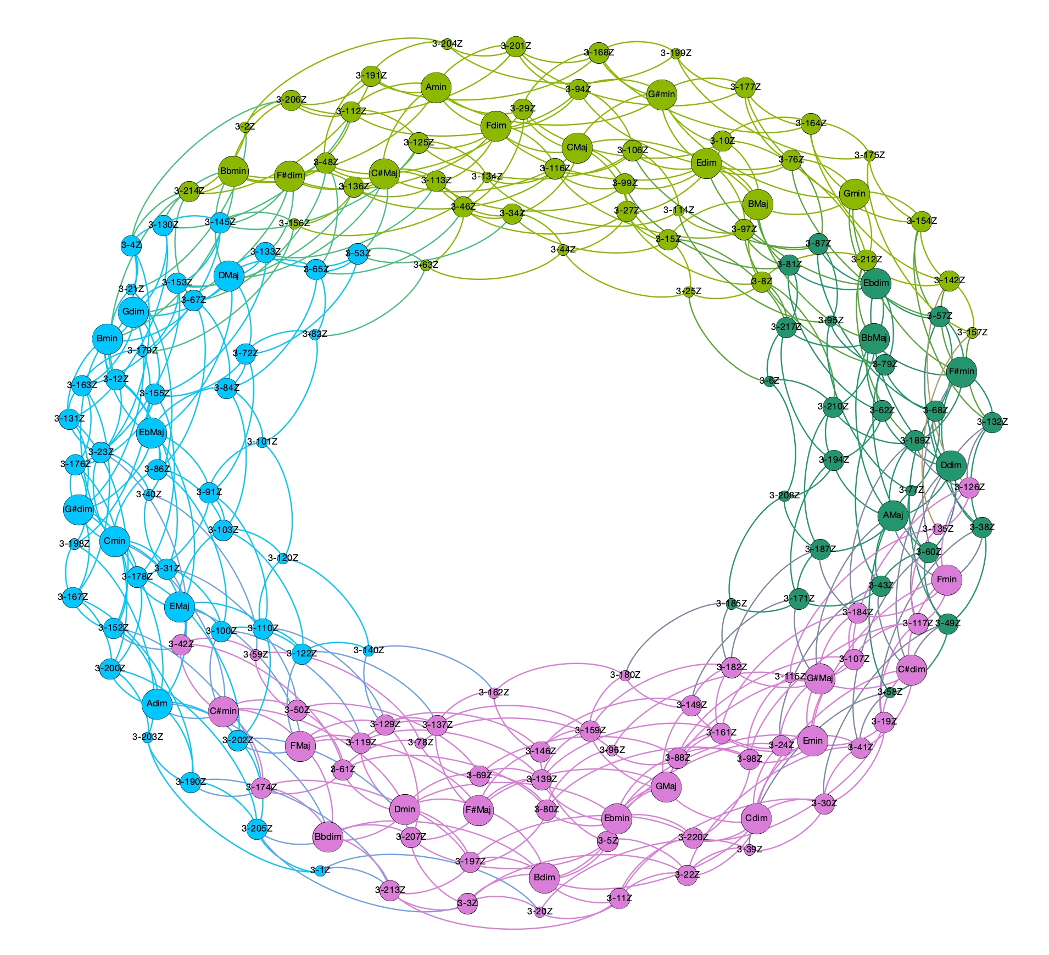
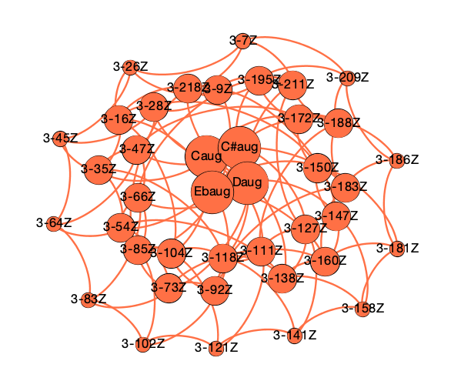
panchromatic normal forms (prime forms + inversions) + O(1,1,1)
Triadic harmony in 12TET
panchromatic voice leading spaces

Slide 18
Triadic harmony in 12TET
panchromatic voice leading spaces
Even some more on distances!
Order of operator O({n_{i}}) is related to functionality in the voice leading space:
operator | distance | weight
O(1) | 1.0000 | 1.0000
O(1,1) | 1.4142 | 0.7071
O(1,1,1) | 1.7321 | 0.5774
O(2) | 2.0000 | 0.5000
O(1,2) | 2.2361 | 0.4472
O(2,1,1) | 2.4494 | 0.4083
O(2,2) | 2.8284 | 0.3536
O(2,2,1) | 3.0000 | 0.3333
O(3) | 3.0000 | 0.3333
O(1,3) | 3.1622 | 0.3162
O(1,1,3) | 3.3166 | 0.3015
O(2,2,2) | 3.4641 | 0.2886
O(2,3) | 3.6056 | 0.2774
O(1,2,3) | 3.7416 | 0.2673
O(4) | 4.0000 | 0.2500
aug ⇨ Maj ⇨ min ⇨ dim, etc.
Cmaj ⇨ Fmin ⇨ F#dim ⇨ F#Maj, etc.
Maj ⇨ Maj or min ⇨ min or Cmaj ⇨ F#dim ⇨ Amin, etc.
Color of nodes = modularity class ➝ measure of the strength of division of a network into communities: dense connections between the nodes within communities but sparse connections between nodes in different communities.

Slide 19
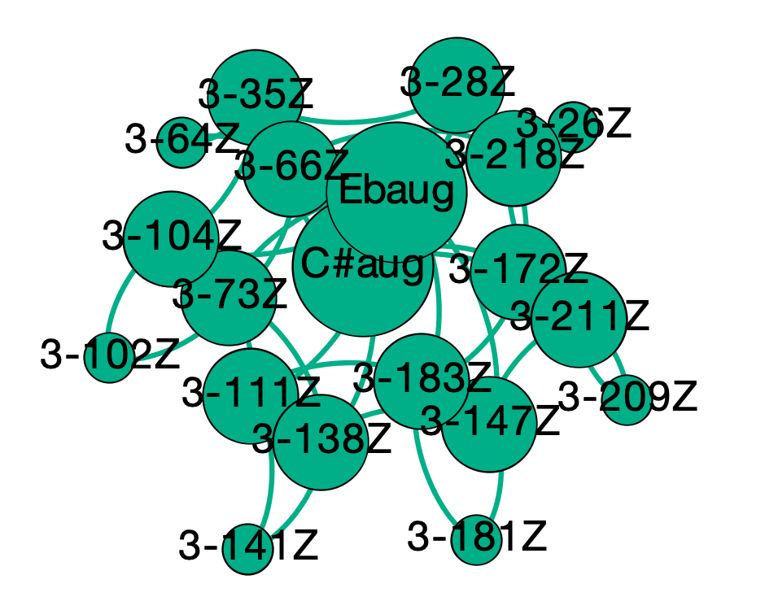
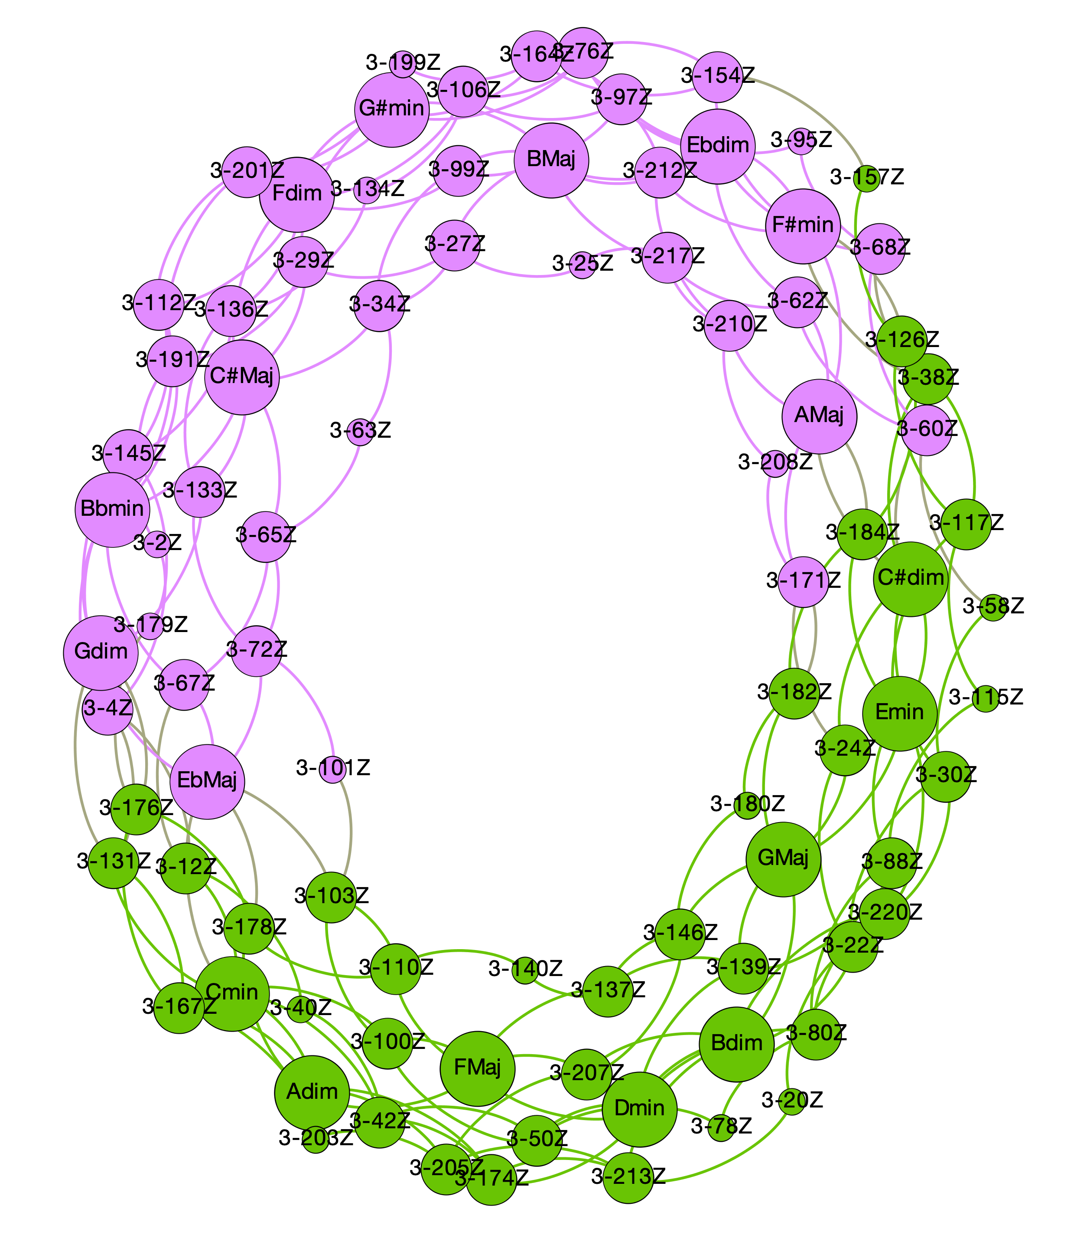
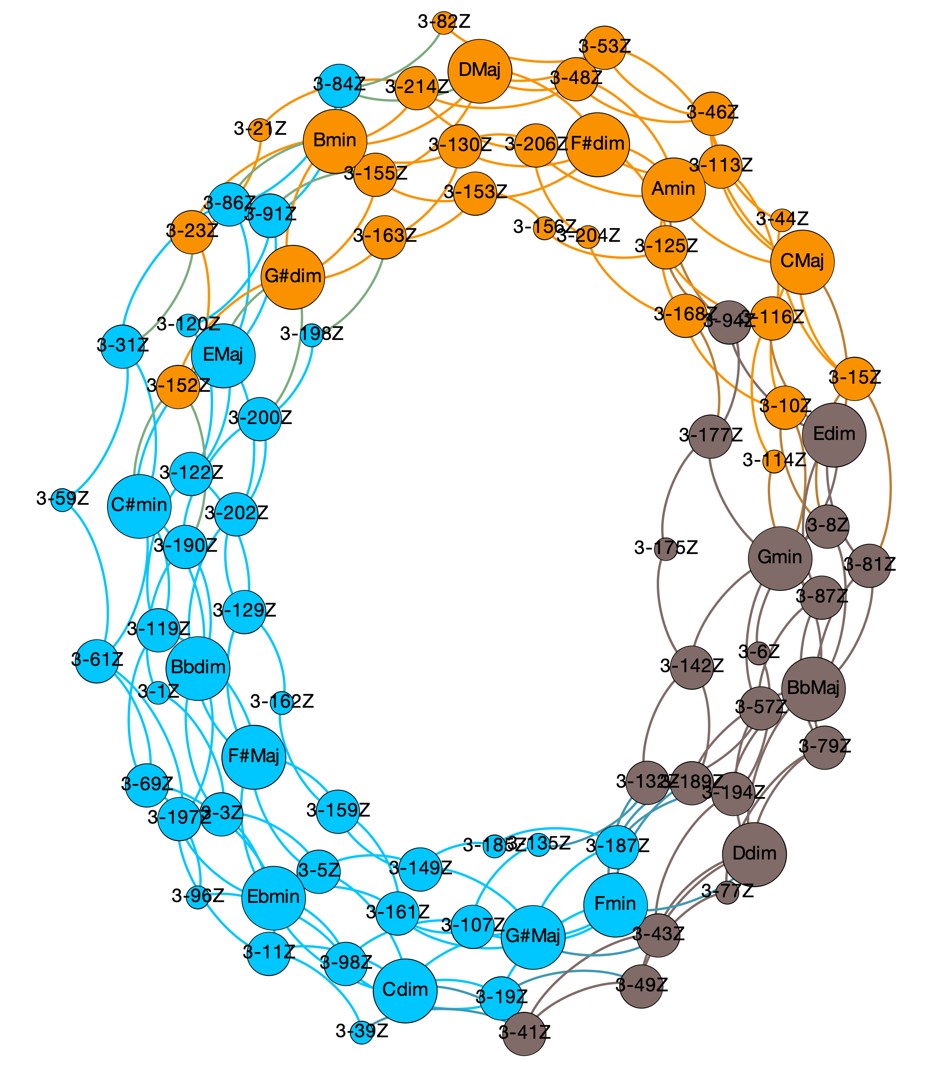
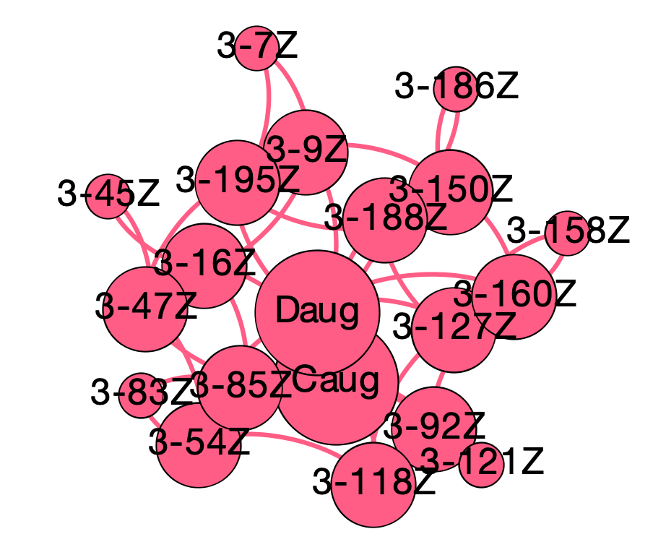
panchromatic normal forms (prime forms + inversions) + O(2)
Triadic harmony in 12TET
panchromatic voice leading spaces

Slide 20
Triadic harmony in 12TET
panchromatic voice leading spaces
Even some more on distances!
Order of operator O({n_{i}}) is related to functionality in the voice leading space:
operator | distance | weight
O(1) | 1.0000 | 1.0000
O(1,1) | 1.4142 | 0.7071
O(1,1,1) | 1.7321 | 0.5774
O(2) | 2.0000 | 0.5000
O(1,2) | 2.2361 | 0.4472
O(2,1,1) | 2.4494 | 0.4083
O(2,2) | 2.8284 | 0.3536
O(2,2,1) | 3.0000 | 0.3333
O(3) | 3.0000 | 0.3333
O(1,3) | 3.1622 | 0.3162
O(1,1,3) | 3.3166 | 0.3015
O(2,2,2) | 3.4641 | 0.2886
O(2,3) | 3.6056 | 0.2774
O(1,2,3) | 3.7416 | 0.2673
O(4) | 4.0000 | 0.2500
aug ⇨ Maj ⇨ min ⇨ dim, etc.
Cmaj ⇨ Fmin ⇨ F#dim ⇨ F#Maj, etc.
Maj ⇨ Maj or min ⇨ min or Cmaj ⇨ F#dim ⇨ Amin, etc.
Cmaj ⇨ Amin ⇨ F#dim ⇨ Dmaj, etc.
Color of nodes = modularity class ➝ measure of the strength of division of a network into communities: dense connections between the nodes within communities but sparse connections between nodes in different communities.

Slide 21
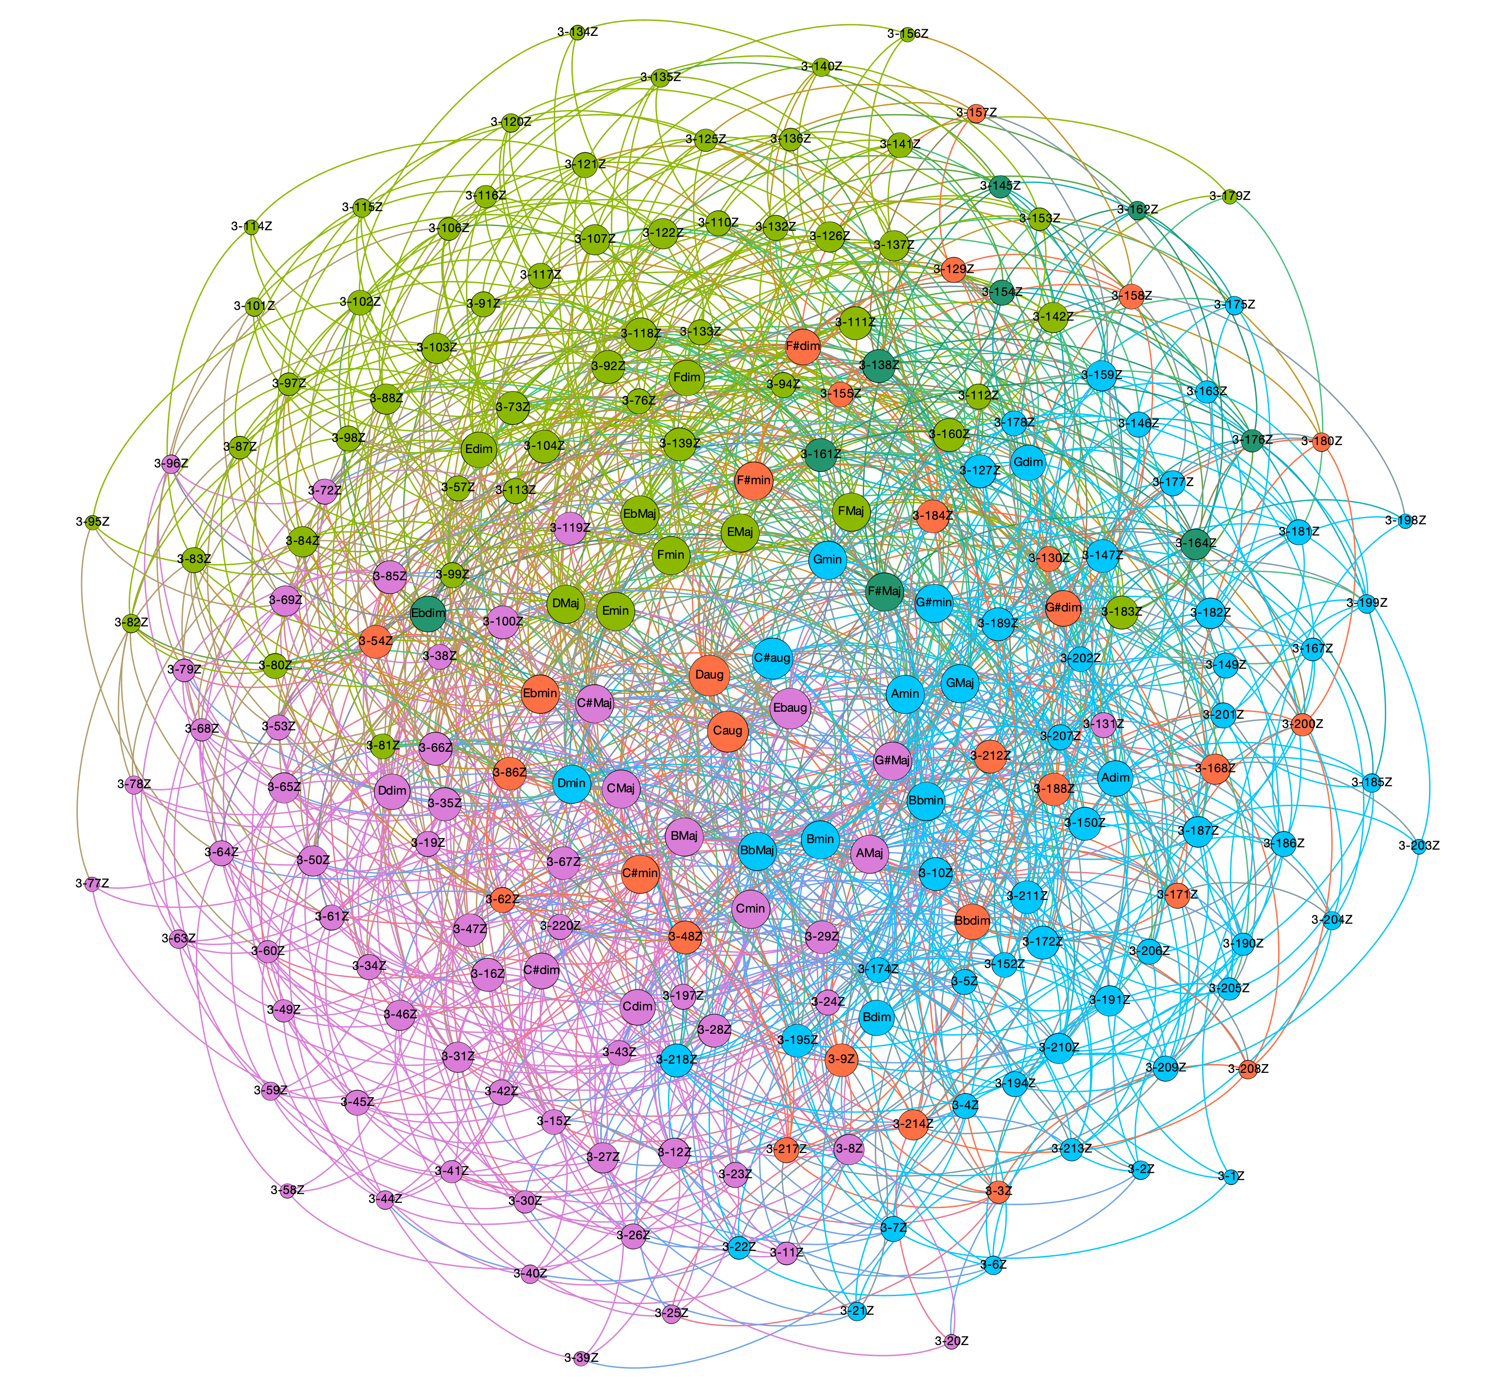
panchromatic normal forms (prime forms + inversions) + O(1,2)
Triadic harmony in 12TET
panchromatic voice leading spaces

Slide 22
Triadic harmony in 12TET
panchromatic voice leading spaces
Even some more on distances!
Order of operator O({n_{i}}) is related to functionality in the voice leading space:
operator | distance | weight
O(1) | 1.0000 | 1.0000
O(1,1) | 1.4142 | 0.7071
O(1,1,1) | 1.7321 | 0.5774
O(2) | 2.0000 | 0.5000
O(1,2) | 2.2361 | 0.4472
O(2,1,1) | 2.4494 | 0.4083
O(2,2) | 2.8284 | 0.3536
O(2,2,1) | 3.0000 | 0.3333
O(3) | 3.0000 | 0.3333
O(1,3) | 3.1622 | 0.3162
O(1,1,3) | 3.3166 | 0.3015
O(2,2,2) | 3.4641 | 0.2886
O(2,3) | 3.6056 | 0.2774
O(1,2,3) | 3.7416 | 0.2673
O(4) | 4.0000 | 0.2500
aug ⇨ Maj ⇨ min ⇨ dim, etc.
Cmaj ⇨ Fmin ⇨ F#dim ⇨ F#Maj, etc.
Maj ⇨ Maj or min ⇨ min or Cmaj ⇨ F#dim ⇨ Amin, etc.
Cmaj ⇨ Amin ⇨ F#dim ⇨ Dmaj, etc.
Circle of fifths
etc.
Color of nodes = modularity class ➝ measure of the strength of division of a network into communities: dense connections between the nodes within communities but sparse connections between nodes in different communities.

Slide 23
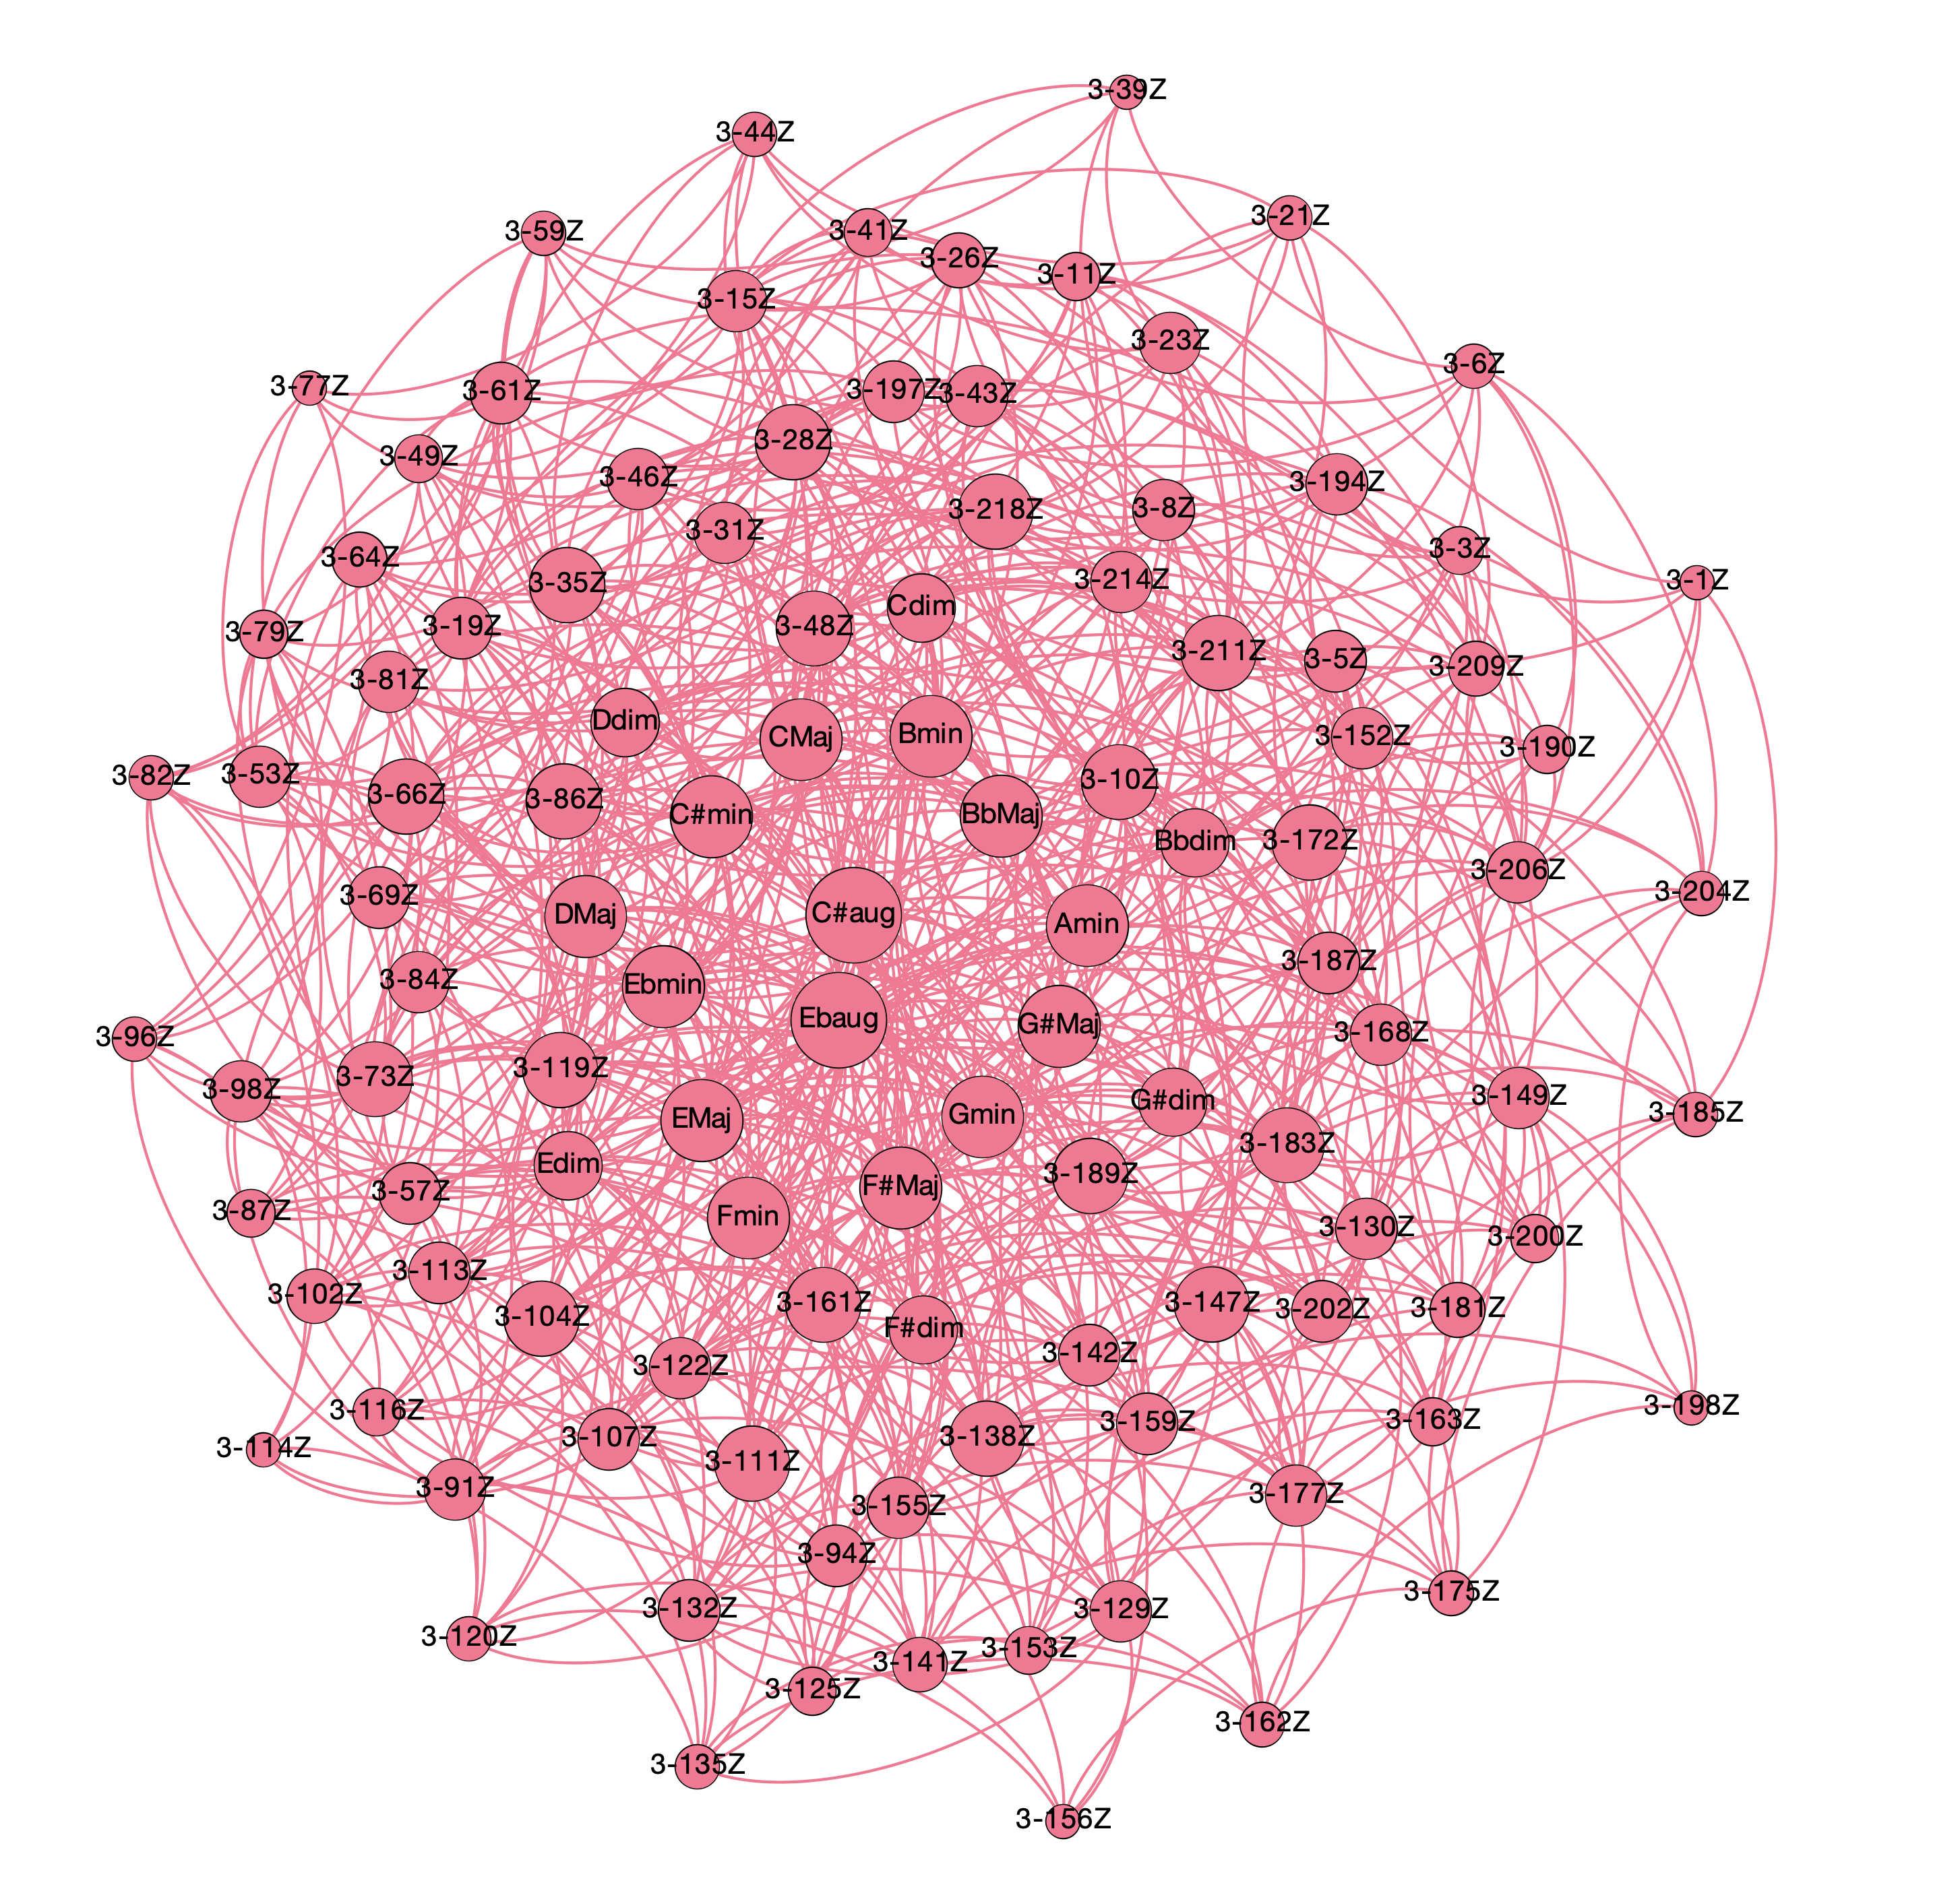
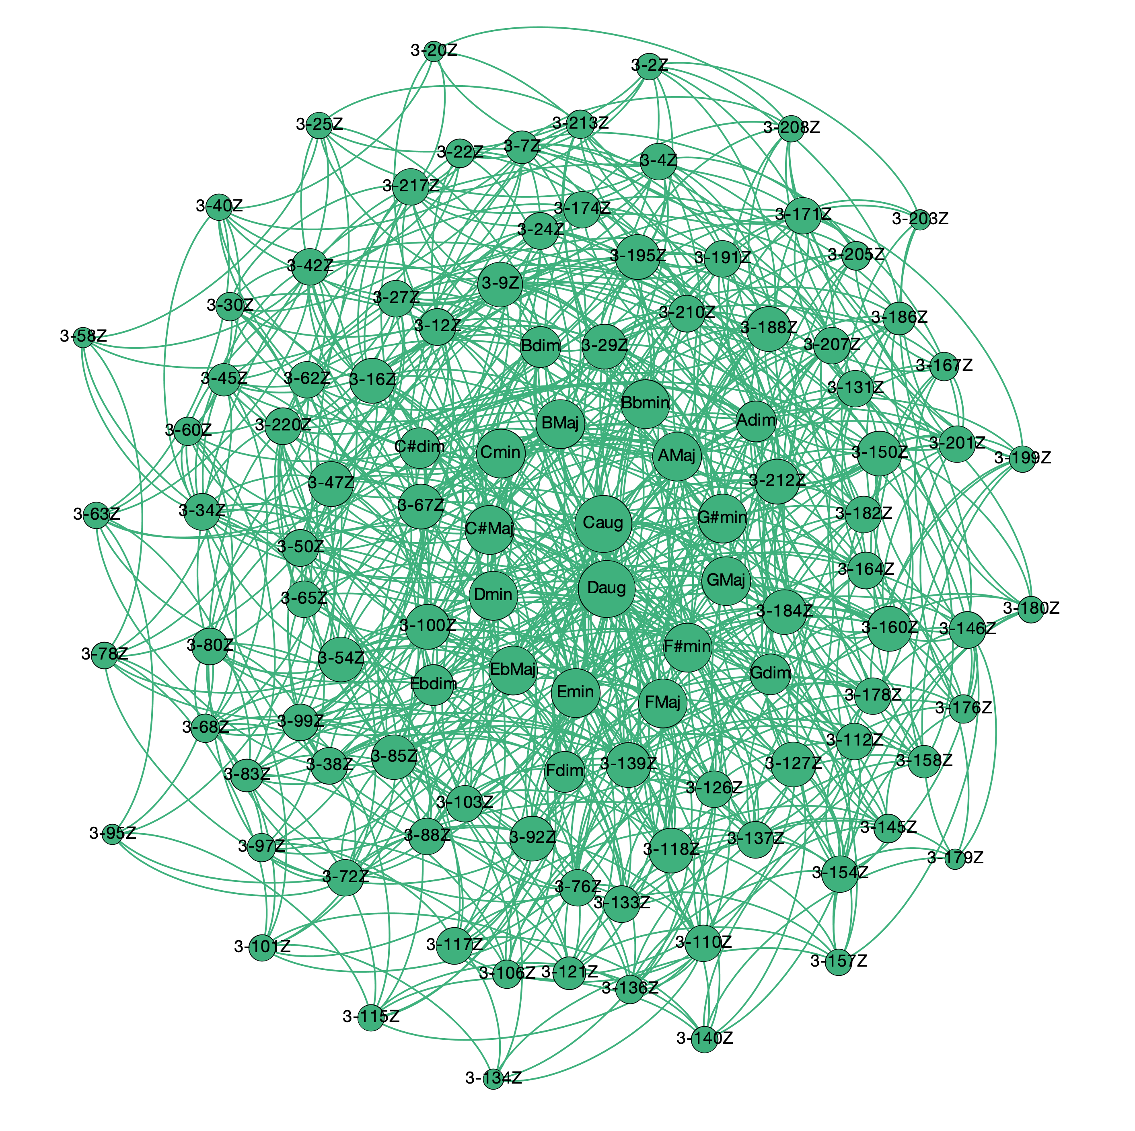
panchromatic normal forms (prime forms + inversions) + O(1,1,2)
Triadic harmony in 12TET
panchromatic voice leading spaces

Slide 24
Triadic harmony in 12TET
panchromatic voice leading spaces
Even some more on distances!
Order of operator O({n_{i}}) is related to functionality in the voice leading space:
operator | distance | weight
O(1) | 1.0000 | 1.0000
O(1,1) | 1.4142 | 0.7071
O(1,1,1) | 1.7321 | 0.5774
O(2) | 2.0000 | 0.5000
O(1,2) | 2.2361 | 0.4472
O(2,1,1) | 2.4494 | 0.4083
O(2,2) | 2.8284 | 0.3536
O(2,2,1) | 3.0000 | 0.3333
O(3) | 3.0000 | 0.3333
O(1,3) | 3.1622 | 0.3162
O(1,1,3) | 3.3166 | 0.3015
O(2,2,2) | 3.4641 | 0.2886
O(2,3) | 3.6056 | 0.2774
O(1,2,3) | 3.7416 | 0.2673
O(4) | 4.0000 | 0.2500
aug ⇨ Maj ⇨ min ⇨ dim, etc.
Cmaj ⇨ Fmin ⇨ F#dim ⇨ F#Maj, etc.
Maj ⇨ Maj or min ⇨ min or Cmaj ⇨ F#dim ⇨ Amin, etc.
Cmaj ⇨ Amin ⇨ F#dim ⇨ Dmaj, etc.
Circle of fifths
etc.
Color of nodes = modularity class ➝ measure of the strength of division of a network into communities: dense connections between the nodes within communities but sparse connections between nodes in different communities.

Slide 25
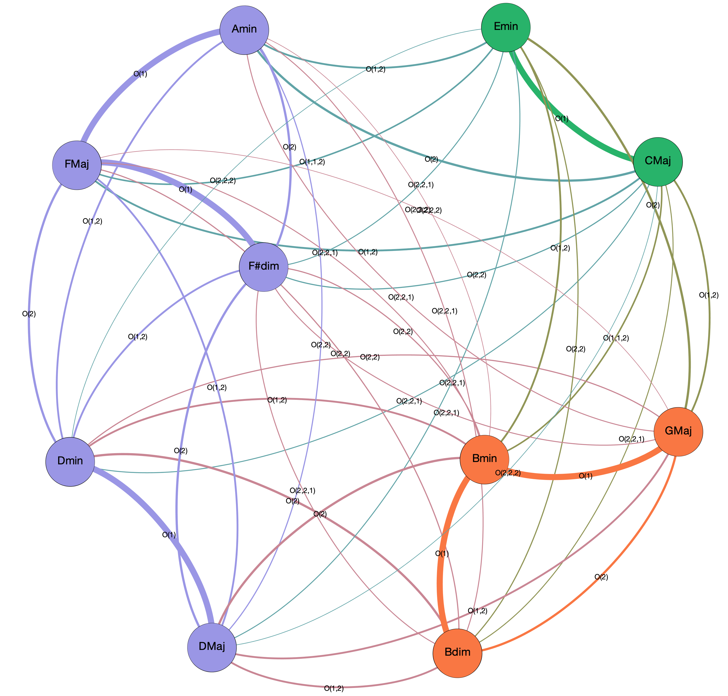
Subspaces of voice leading spaces: tonal spaces and common practice harmony
Subspace of C Maj and G Maj keys – diatonic triads
Defines a subset in the operator space:
O(1)
O(2)
O(1,2)
O(1,2,2)
O(2,2)
O(2,2,2)
For instance, this graph contains all the information needed to construct modulation sequences in the union of the C Maj and G Maj keys subspaces

Slide 26
Subspaces of voice leading spaces: tonal spaces and common practice harmony
Measure of the “strength” (parsimony*) of a progression as sum of the weights of the connecting segments:
FMaj ⇨ F#dim ⇨ GMaj
strength = 1.3333
FMaj ⇨ DMaj ⇨ GMaj
strength = 0.8944
Generalization and extension of traditional music-theoretical functionalities – extended tools for composition and analysis
?
Parsimony ⟺ Perception
*see Tymoczko, Science 313 (2006)

Slide 27
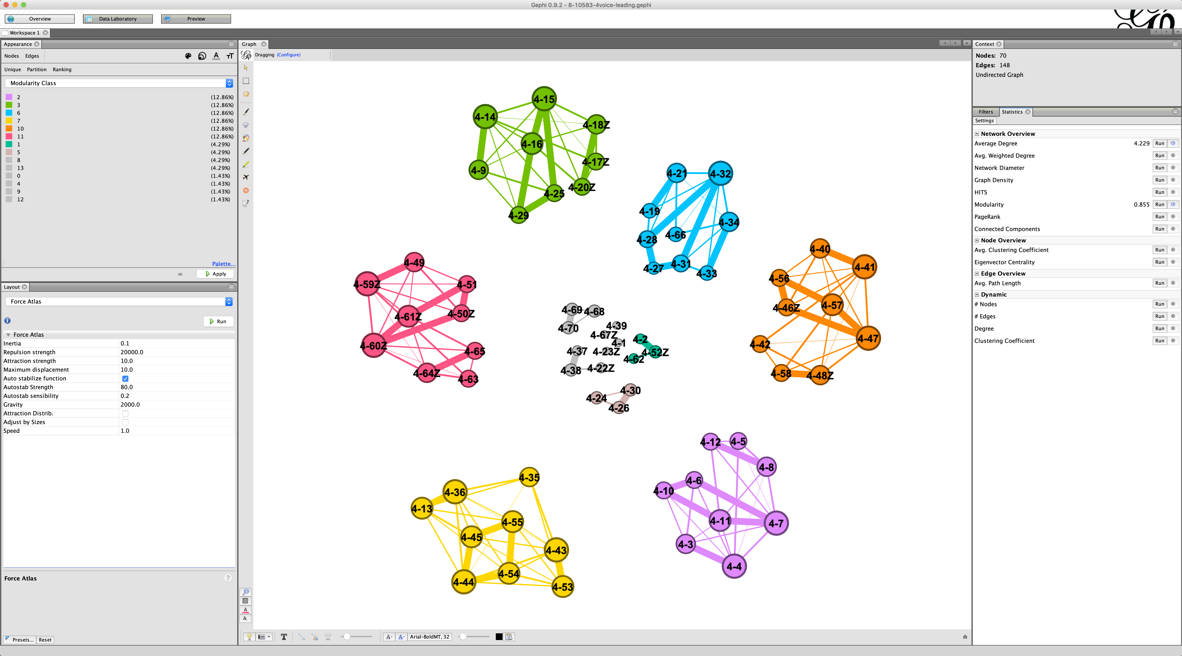
Subspaces of voice leading spaces as compositional frameworks: 8-10583 in 24TET
Gephi: a real-time interactive workspace – 4 voices

Slide 28
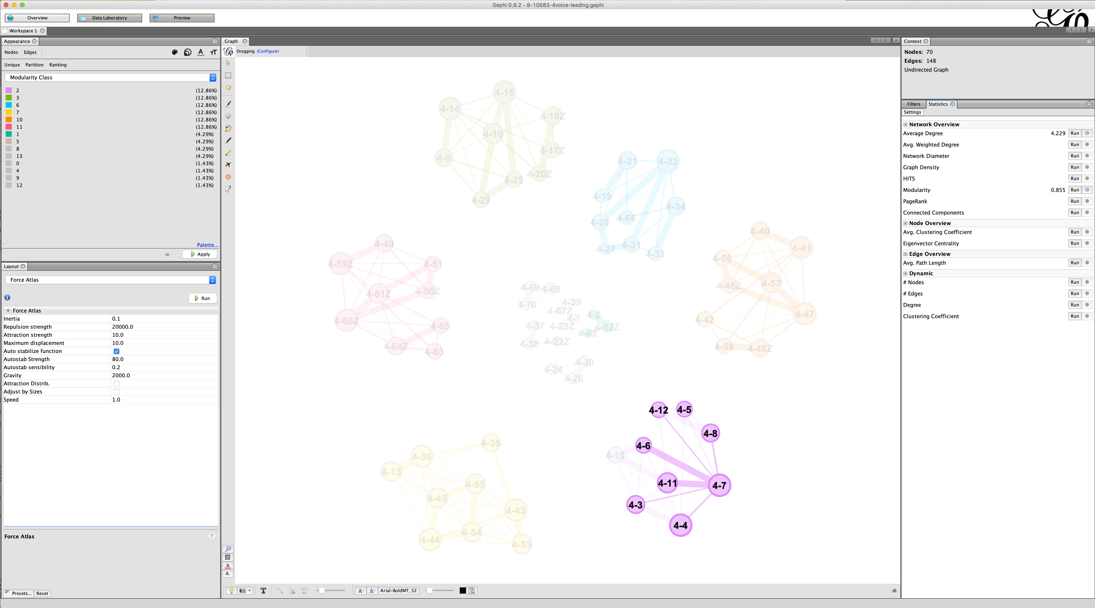
Subspaces of voice leading spaces as compositional frameworks: 8-10583 in 24TET
Gephi: a real-time interactive workspace – 4 voices
all possible
chord
progressions!

Slide 29
pcsPy: a python utility for generalized pitch class set classification, analysis and composition
Freely available at https://github.com/marcobn/pcsPy
www.materialssoundmusic.com

